Slide 1
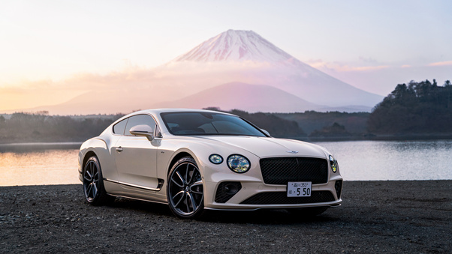
CAR PRICE PRIDICTION:
Name: HIRAPARA KHUSHI
ER NO.:23002171310055
ROLL NO.: 21 BRANCH: CST

Slide 2

Project Outline
Project Objective
Features
Technologies
Future Scope
Demo

Slide 3

Project Objective
Analyze the key factors influencing car prices using exploratory data analysis
Collect and preprocess car price data, categorical variables, and feature scaling.
Develop a predictive model using Random Forest Regressor to estimate car prices.
Deploy the model as a Flask web application for easy user interaction.

Slide 4
Features
User-Friendly Interface
Basic Car Details
Usage
Engine & Performance

Slide 5

Technologies
Frontend:
HTML
CSS
BOOTSTRAP
Backend:
Flask(python)

Slide 6
Future Scope
Real-Time Data Integration
Mobile & Web application development
Global expansion

Slide 7
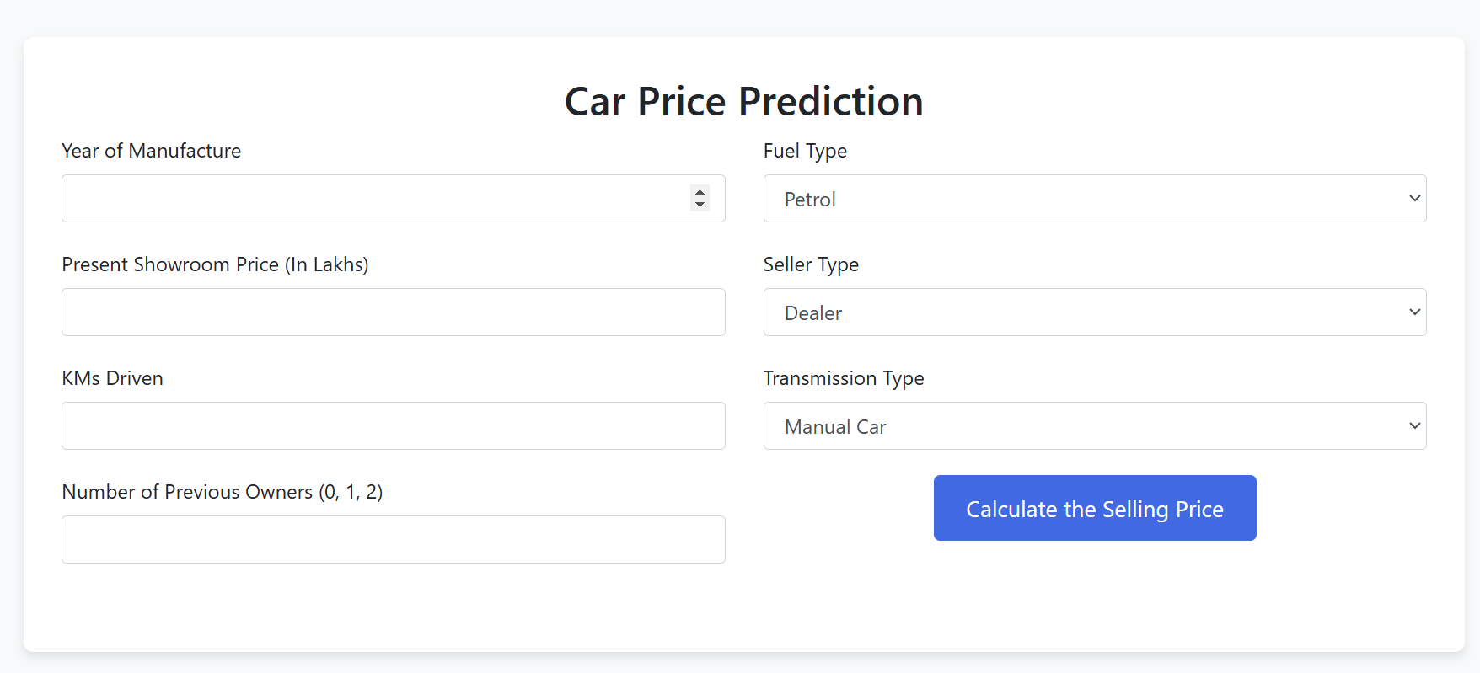
Demo

Slide 8
Thank You…

